Slide 1
Explanatory notes

Slide 2
1 . PARTS OF SPEECH
1 . Answer : D - vivid reason
Vividly is an adverb , vivid is an adjective , we need an adjective before a noun called reason here .
2 . Answer : D – rather unjustified ….not fairly .
Fairly is used in positive sense , rather is used in negative sense .

Slide 3
3 . ANSWER : C – costly enough ……. We use ENOUGH after an adjective not before it .
Good enough , Rich enough , strong enough , fair enough etc .
4 . ANSWER : B – keep “ of “ after inspite
Inspite takes of after it , despite does not take of .
5 . ANSWER : B - remove therefore …… it is unwanted here

Slide 4
6 . ANSWER : B - Remove IF
Supposing and if both of them have the same sense of doubt , we cannot use two words which convey the same meaning .
7 . ANSWER : C – remove THEN …….it is unwanted here .
8 . ANSWER : C – use THAT in place of AND .
When we want to emphasize a result or an aim , we use SO – THAT which means IN ORDER THAT .
He works hard so that he can win . She is so rich that she can buy a Benz car , he is so wise that he can answer any question .

Slide 5
VERB
1 . ANSWER : C – when it collapsed .
was collapsed is passive voice and it cannot be in passive …….because collapse is an intransitive verb .
2 . ANSWER : A – does it matter .
Do / does / did and do not / does not / did not take first form of the verb …..and without S
Ex : Does he speak French ? She does not come here .
3 . ANSWER : C – passing
With a view to takes gerund , not first form of the verb . GERUND means a verb expressed in ING form with out a helping verb .

Slide 6
4 . ANSWER : A - he left us ( simple past tense ) not… he has left ( present perfect tense ) time is mentioned ( a month ) , so we have to use simple past .
5 . ANSWER : C – she had not visited her mother .
We need past perfect tense for the first action in past and simple past for the second action .
6 . ANSWER : B - I have been suffering .
We use present perfect continuous tense to refer to an action along with the duration ( fortnight which means 15 days )

Slide 7
7 . ANSWER : A - I sent
A past action with time should be expressed in simple past not present perfect .
8 . ANSWER : A – did they have a car ?
The verbs that cannot be with ING form :
Possess , have , own , love , like , hate , feel , want , hear , sense , smell , sound , taste , believe , know , remember , understand .
HAVE….. cannot be with ING only in the sense of POSSESS ., in other senses like TAKE , RECEIVE , EXPERIENCE …we can use it with ING .

Slide 8
EX : he is having a lot of money ( possess )
He is having his books ( receive )
9 . ANSWER : C – driving
BE + USED TO AND GET + USED TO TAKE GERUND ( VERB 4TH FORM )

Slide 9
ARTICLES
1 . The richest country
Superlative degree takes the before it .
2.No article – we cannot use article before material nouns .
3 . No article - we can’t use article before abstract noun .
4 . An heir – it begins with consonant H but its sound begins with vowel .
5 . The man – we use definite article to point at something / someone specifically .

Slide 10
6 . The first – we use the before ORDINAL numbers like the first ,the second, the fifth , the tenth etc .
7 . No article – words like school , college , university , hospital , church , mosque , temple , bed cannot be used with articles when they are used with primary purpose .
8 . The Gita – names of holy books take definite article THE RAMAYANA ,THE QURAN , THE BIBLE , THE BHAGAVADGITA .

Slide 11
1 . He is the Vivekananda of our college - when we compare a proper noun with another , we use article before the compared proper noun .
He is the Einstein of our town ( most intelligent man of our town )
He is an Einstein of our town ( he is one of the most intelligent persons of our town )
2 . The higher , the cooler . – when we use two comparative forms in a sentence , before both of them we should use THE .
The older we grow , the wiser we become .

Slide 12
3 . The cleverer of the two boys – we use the before comparative degree when the comparison is mentioned with the word TWO .
Ex : He is the stronger of the two captains ,
She is the wiser of the two sisters .
4 . The real essence of life
5 . No correction is needed , a year is correct .
6 . In summer – no article is used before names of seasons .
7 . Breakfast should be light – we cannot use article before names of meals unless they are made particular .

Slide 13
8 .The guitar – we use THE before names of musical instruments .
But we can use a in the sense of one
She is good at playing the veena
She has a veena at home .
9 . I go to the college – college is used for secondary purpose .
10 . The English – as the name of language , we don’t use article but when we talk about the people of England , we use the English .

Slide 14
1 . For 2 . of 3 . With
PREPOSITIONS
4 . To ( compare takes with when the comparison is between things that are similar , to when it is between things that are dissimilar )
5 . To – for ( responsible and answerable to someone for something .
6 . From 7 . Cope with 8 . By 9 . For ( taste , desire , inclination , passion ….take for )
10 . To ( agree with someone to something )

Slide 15
Prepositions – practice exercise 2
1 . Among 2 . Since 3 at 4 from 5 of ( speak of : specific reference , speak about : general reference )
6 . To 7 to 8 to 9 for 10 for
Practice exercise 3
1 . ANSWER : C ( To in place of than ) prefer and preferable take to not than .
2 . ANSWER : C ( remove for ) order as a verb does not take any preposition but as a noun it takes FOR .

Slide 16
3 . ANSWER : B ( married to )
4 . ANSWER : B …. AT the strange symptoms .
( puzzled , confused , Shocked , Surprised , Astonished by someone , at something . )
5 . ANSWER : A …… parted from
( part from someone – part with something )
6 . ANSWER : B ……acquitted of
Convict , acquit , accuse , guilty take of

Slide 17
7 . ANSWER : C
Enter does not take INTO when used in the sense of MOVING INTO A PLACE , but when used in the sense of INVOLVE ….it takes INTO .
Ex : He entered my office at 10 a.m.
He entered into an argument with me .

Slide 18
8 . ANSWER : B …..cope with ( remove up after cope . )
Cope takes with .
9 . ANSWER : A
In spite takes of - despite does not take of .
Ex : in spite of working hard , he couldnot get success .
Despite working hard , he could not get success .

Slide 19
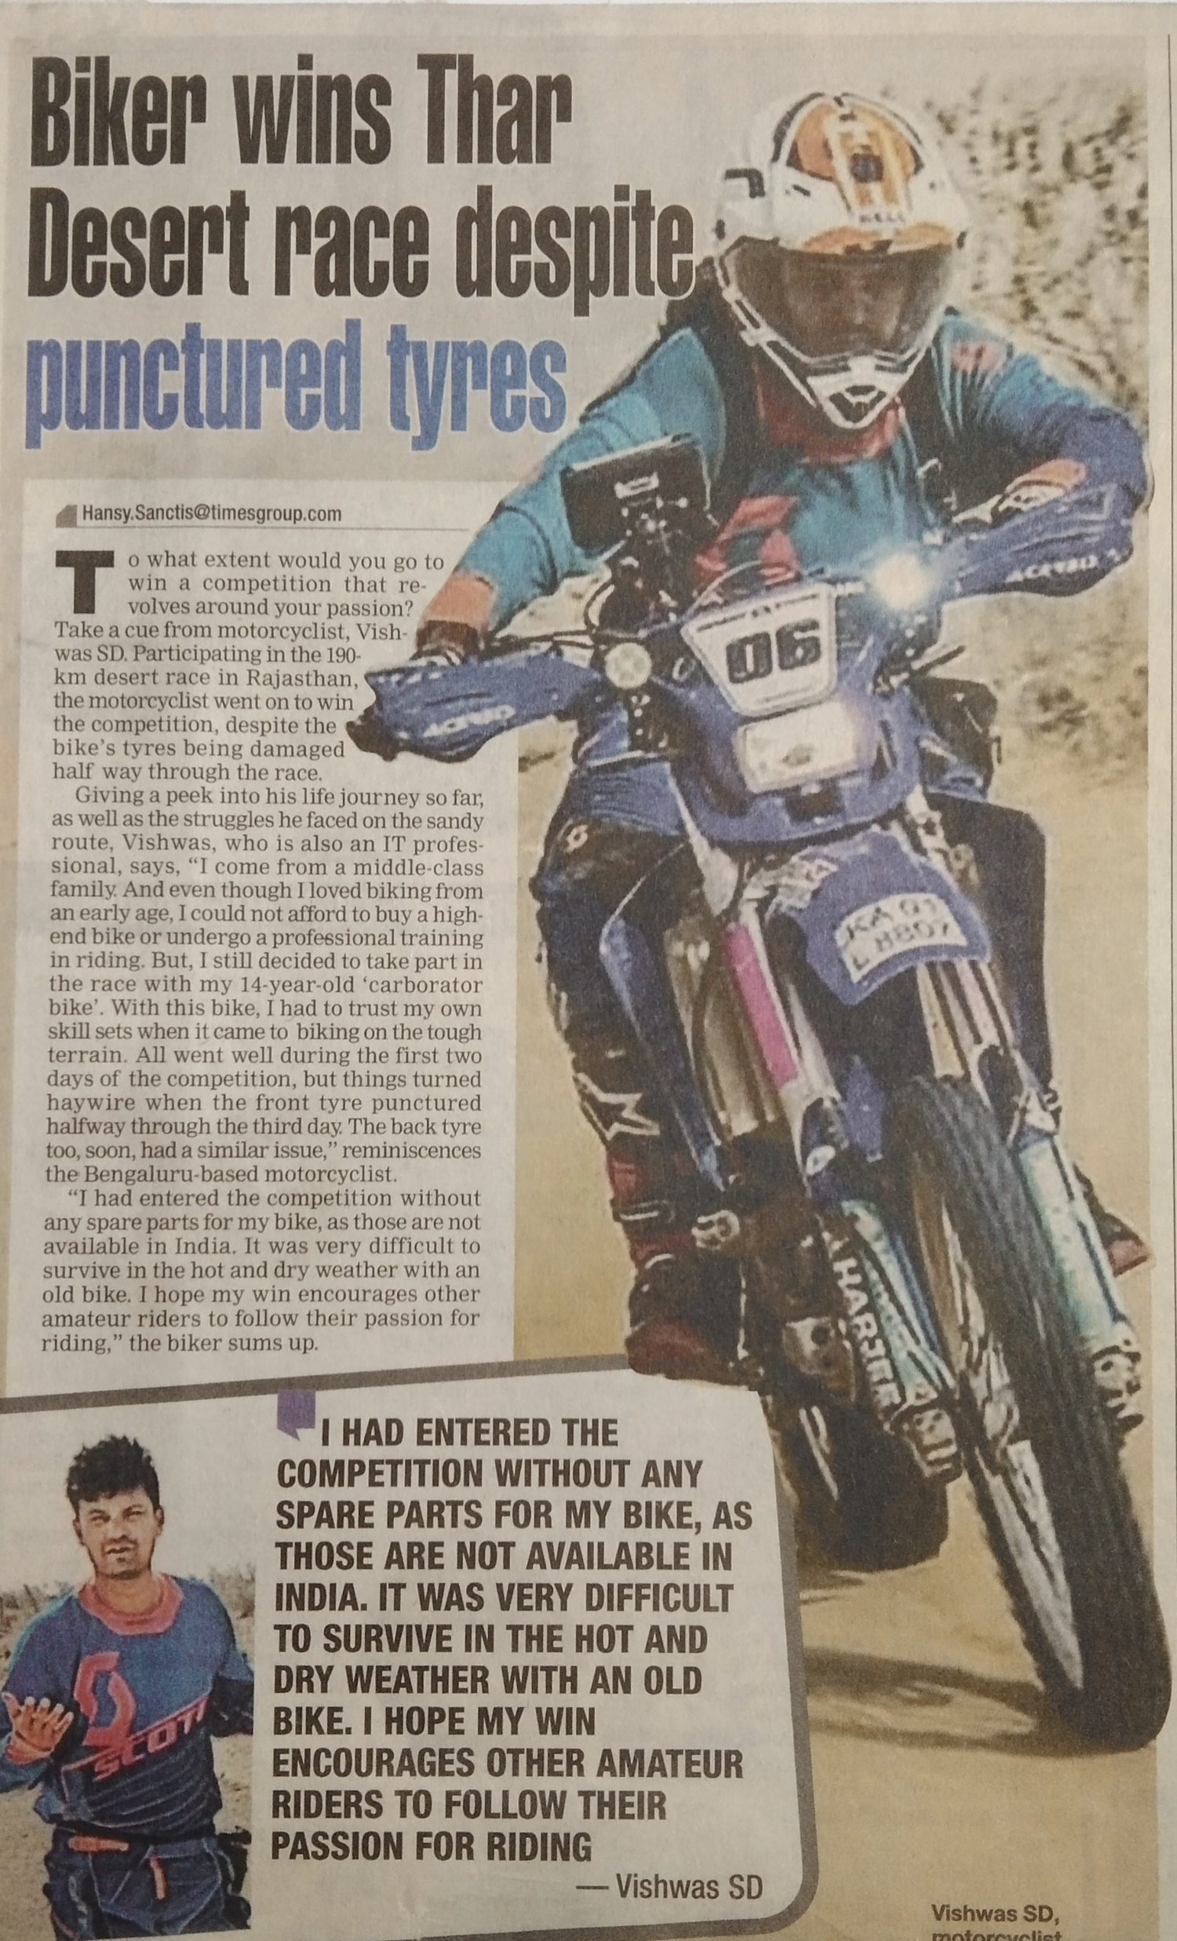

Slide 20
CONDITIONAL SENTENCES

Slide 21
1 .ANSWER : B ( would have arrived )
Type 3 conditional
2 . ANSWER : B
( had expanded )
Type 3 conditional
3 . ANSWER : A ( snores )
4 . ANSWER : A ( don’t receive )
Type 1 conditional – negative

Slide 22
5 . ANSWER : A ( had not taken )
Type 3 conditional – negative .
6 . ANSWER : C ( will not pass )
Type 1 – negative …… “ unless she calms down is a substitute to if she does not calm down “.
7 . ANSWER : B ( were )
( Type 2 – status verb – imaginary situation )

Slide 23
8 . ANSWER : D ( would try )
Type 2 – imaginary
If + subject + were takes past modal ( would , should , could , might )
9 . ANSWER : A ( would come )
Type 2 conditional
10 . ANSWER : A ( would be )
Type 2 conditional

Slide 24
11 . ANSWER : B ( will watch )
Type 1 conditional …….. ARE is present status verb .
12 . ANSWER : A ( had not broken )
Type 3 – negative
13 . ANSWER : A ( won’t help )
Won’t is the short form of will not
Type 1 – negative

Slide 25
MISCELLANEOUS

Slide 26
1 . ANSWER : A – ( hardly had the inspector )
did + subject + verb 1 + object
+
hardly
Subject + verb 2
Had + subject + verb 3 + object
When we talk about two actions that happen immediately one after the other in the past , we use the above structure of the sentence .

Slide 27
2 . ANSWER : A ( he laid the watch )
To be
LIE – LAY – LAIN
To rest
To place
LAY – LAID – LAID
To keep

Slide 28
3 . ANSWER : A ( it being a sunny day )
When a sentence has BEING …….see that there is a subject in it , the subject can be a noun or pronoun and it can be either in the beginning ( before BEING ) or in the middle of the sentence .
EX : being an I.A.S. officer , everyone respects him . ( wrong )
Mr. Amit / he being an I.A.S. ……………. ( correct )
Being an I.A.S., Mr Amit / he is respected by everyone .
We need to use IT for things , he or she for persons as a pronoun .

Slide 29
4 . ANSWER : A ( manufactures not only )
When we use words like not only - but also , either- or , neither – nor , we should link them with the two things that they represent…. first one with not only , second one with but also ….first one with either , second one with or …first one with neither , second one with nor .
Not only leather goods but also plastic ware .

Slide 31
5 . ANSWER : A ( when I meet you )
See the next slide for explanation

Slide 32
when
If
unless
until
As soon as
SUB + V 1
As early as
before
after
We use simple present tense ( subject + verb 1 ) with these words to refer to a future action .
By the time

Slide 33
6 . ANSWER : A ( he left )
A past action with time should be in simple past tense …not present perfect tense .
7 . ANSWER : B ( he became angry with me )
Angry with someone at something .

Slide 34
8 . ANSWER : B ( than in place of when )
+
Did + subject + verb 1
+
+
+
No sooner
than
subject
Verb 2
Had + subject + verb 3
When we talk about two actions that happen immediately one after the other in the past , we use the above structure of the sentence .

Slide 35
9 . ANSWER : B ( to / up to in place of till )
Till is used for time not the place .
10 . ANSWER : C ( he had bought it )
When two actions take place in the past , the first one should be in past perfect tense and the second action should be in simple past .
Buying the knife is the first action and losing it is the second action .

Slide 36
11 .
ANSWER : A ( Many a student is )
Many a + singular subject + singular verb .
12 . ANSWER : B ( remove more than )
Exceed itself means to be more than needed , we cannot use two expressions that give the same meaning .
13 . ANSWER : B ( remove for )
The word ENSURE does not take any preposition after it .

Slide 37
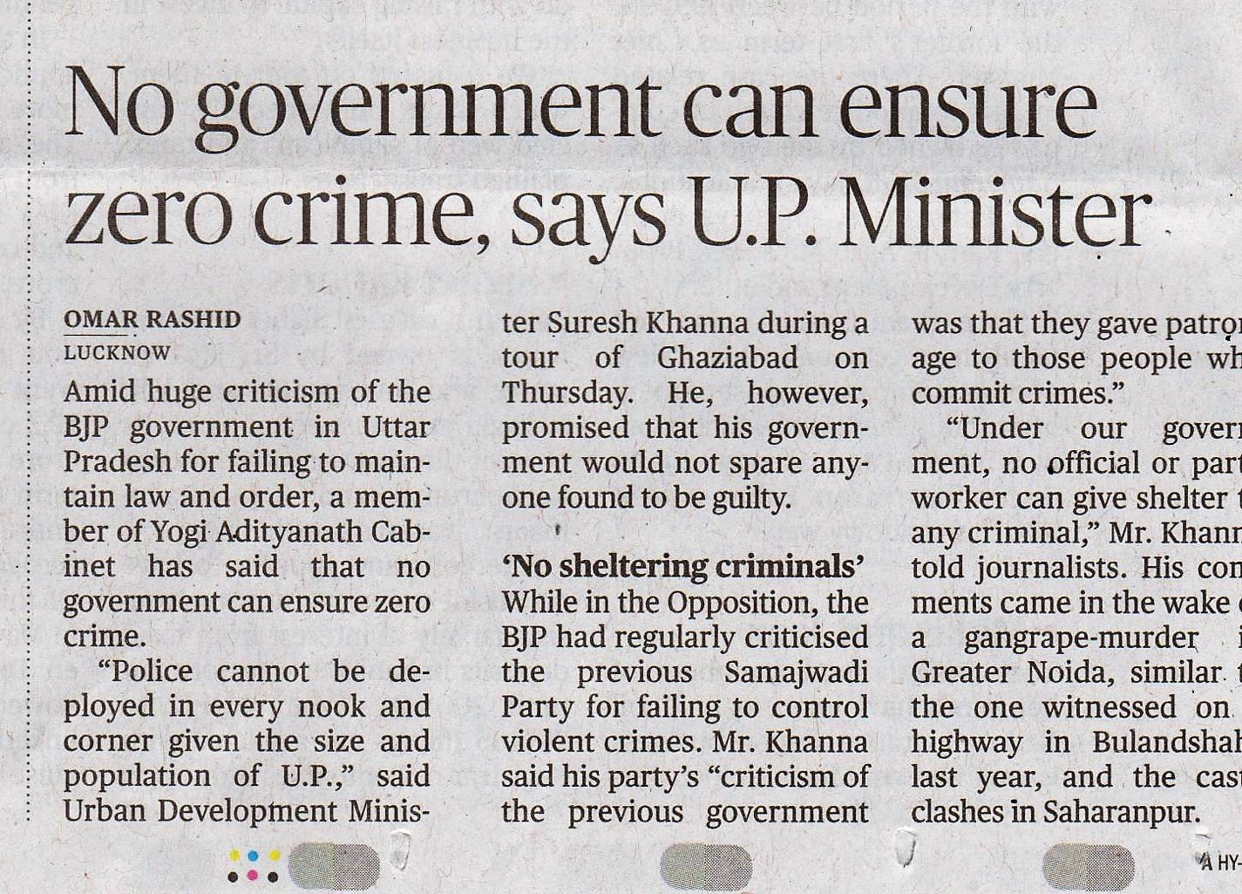

Slide 38
14 . ANSWER : B ( use me instead of myself )
A preposition is followed by the object case of pronoun
I
ME
MY
MYSELF

Slide 39
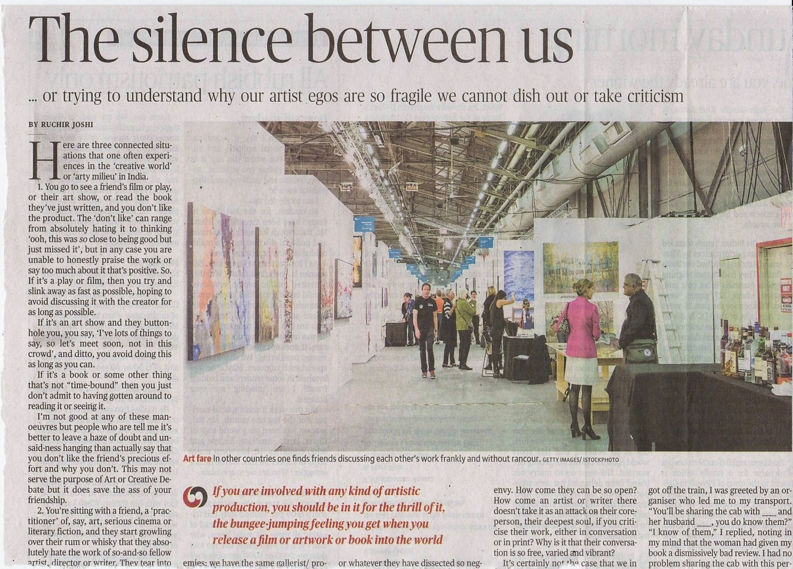
US is the object case of WE

Slide 40
15 . ANSWER : A ( acting on inside information )
Acting takes on …. not from

Slide 41
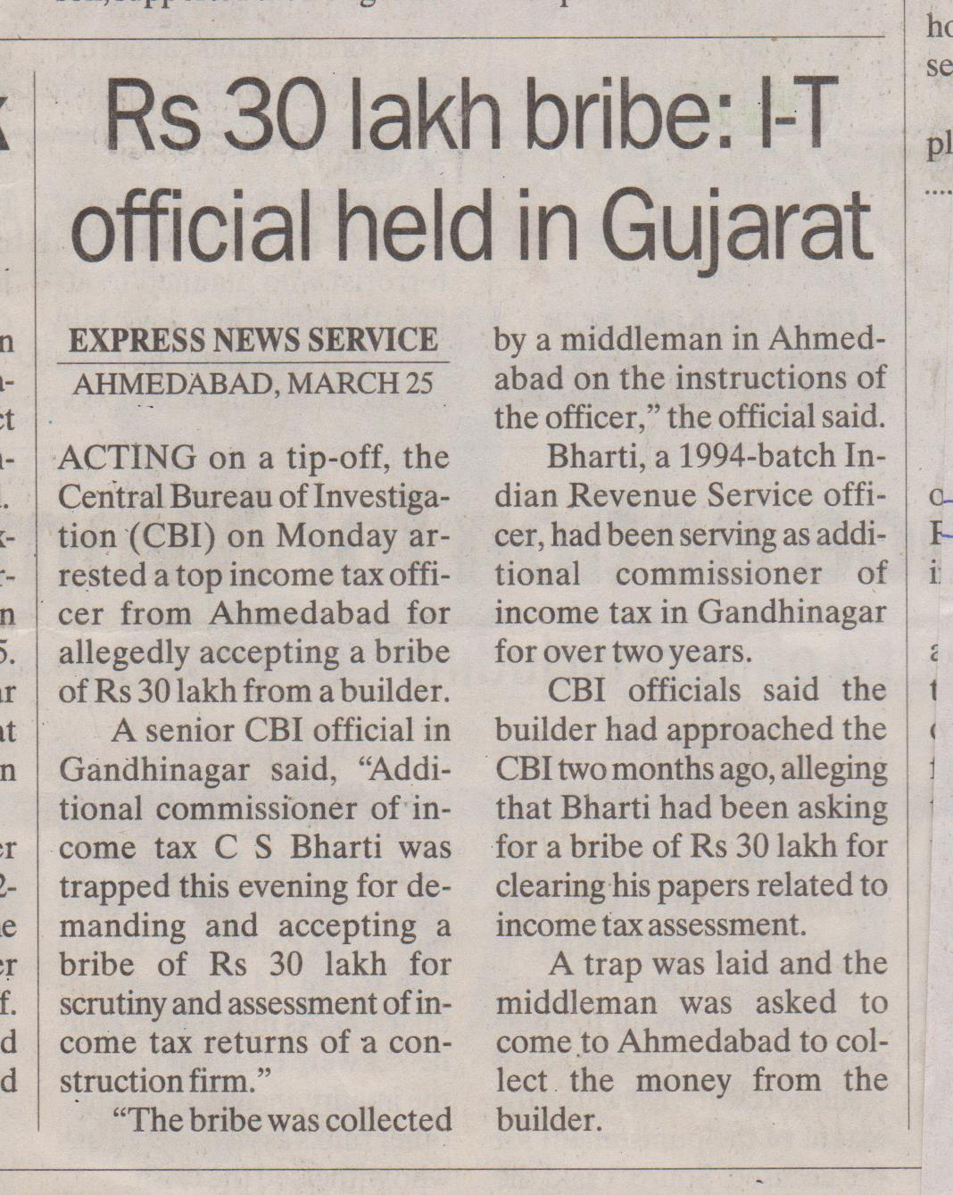

Slide 42
16 . ANSWE : C ( alternate days )
Alternative : substitute ( one in place of another )
Ex : Maths teacher could not come , they sent reasoning lecturer as alternative to maths class .
Alternate : every other / every second .
Ex : we had classes on alternate days like Monday , Wednesday and Friday .

Slide 43
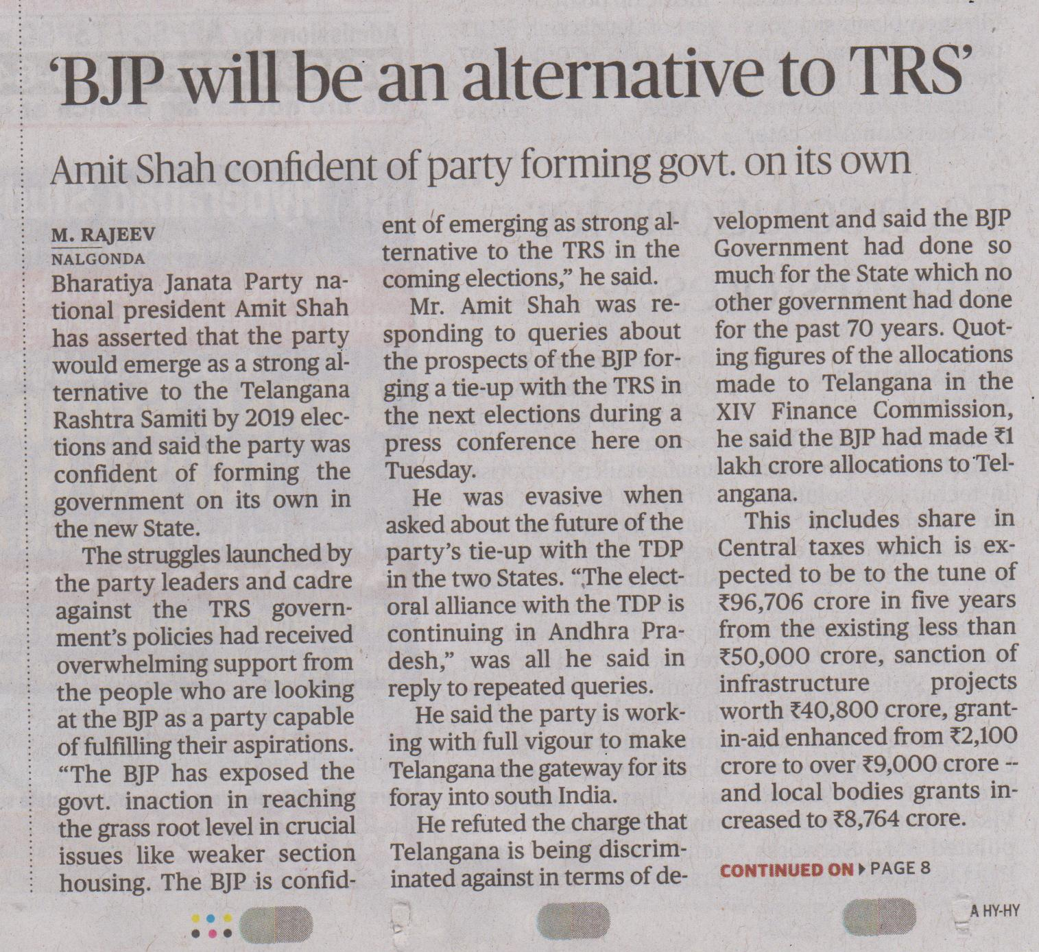

Slide 44
17 : ANSWER : C ( is extremely fond )
Many a takes singular noun and singular verb .
18 . ANSWER : C ( on mahatma ‘ s call )
On is the suitable preposition here .
19 . ANSWER : B ( was very weak )
Present becomes past in INDIRECT speech .

Slide 45
20 . ANSWER : C ( on the table )
We use ON if the object is in contact with the surface and we have to use OVER if there is a gap between the object and surface .
Ex : The bag is on the table .
The fan is over your head .

Slide 46
21 . ANSWER : C ( means in place of mean )
Mean : intend . Ex : what do you mean ?
Mean : bad . Ex : he is so mean .
Means : resources , ways .

Slide 47
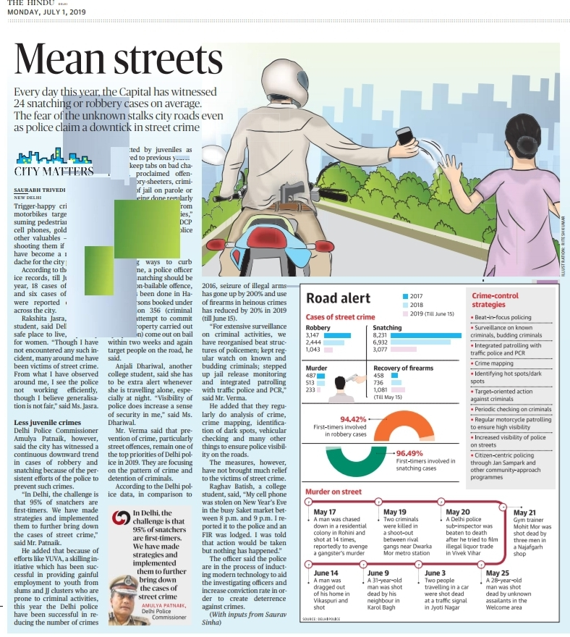

Slide 48
22 . ANSWER : B ( remove on the contrary )
But and on the contrary have the same meaning ….and we cannot use two words that convey the same sense .
23 . ANSWER : A ( how do birds know )
It is a question and it needs a verb before the subject .

Slide 49
24 . ANSWER : C ( conclusive remarks )
Conclusive / concluding remarks .
We use ADJECTIVE before a noun .
Conclusion remarks
NOUN + NOUN
Conclusive remarks
ADJECTIVE + NOUN

Slide 50
25 . ANSWER : A offered either to exchange
We are talking about two options called exchange and refund , either should be linked with exchange and or should be linked with refund .
SEE QUESTION NUMBER FOUR FOR EXPLANATION N BETTER CLARITY .

Slide 51
26 . ANSWER : NO ERROR
27 . ANSWER : C ( remove NOT )
Should takes LEST and it is a negative word , hence it cannot take another negative word .
Ex : work hard lest you should fail .
Walk fast lest we should miss the bus .

Slide 52
28 . ANSWER : C ( remove AS )
Call / consider / elect do not take “ AS “ .
Ex : I call her sister .
He calls me sir .

Slide 53
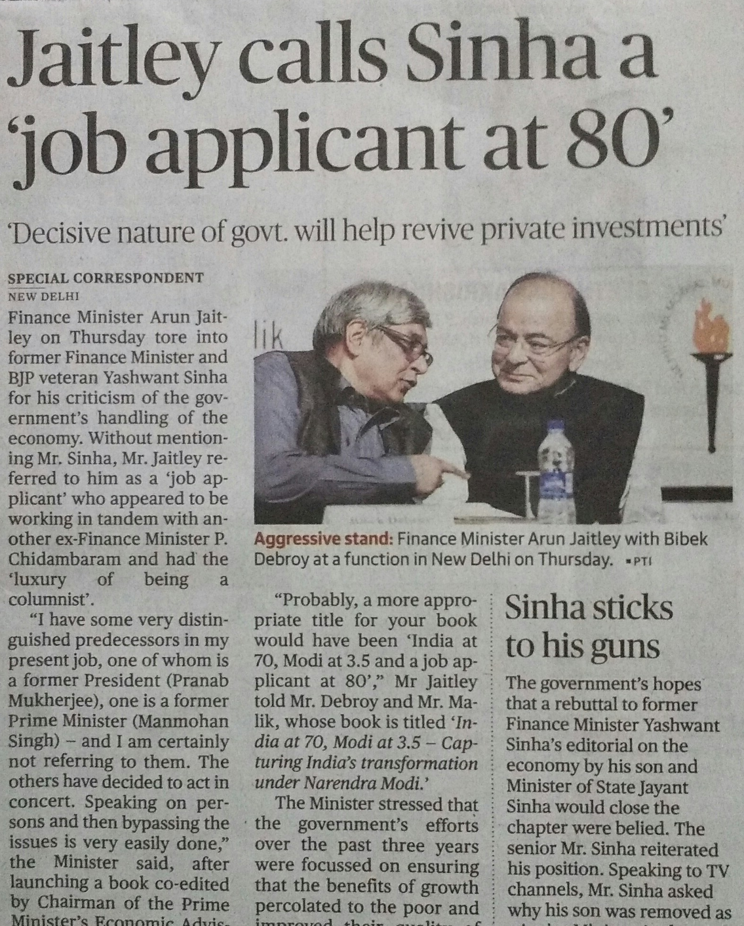

Slide 54
29 . ANSWER : A ( came back in place of reached back )
The word REACH cannot be used with back .
30 . ANSWER : C ( superior to )
Words ending with IOR take TO not THAN .
Senior , junior , inferior , superior , exterior ,ulterior , posterior , prior take TO

Slide 55
31 . ANSWER : C ( where did you buy it from ? )
A question needs a verb before subject .
32 . ANSWER : A ( miserly man )
A noun takes an ADJECTIVE before it .
It should be either a miser or a miserly man .

Slide 56
Miser man
NOUN + NOUN
Miserly man
ADJECTIVE + NOUN

Slide 57
33 . ANSWER : B ( all that glitters )
34 . ANSWER : A ( entrusted with )
35 . ANSWER : C ( with a view to receiving )
With a view to takes GERUND ( a verb expressed in ING form without helping is called a GERUND )

Slide 58
ENJOY , MIND , MISS , AVOID , REMEMBER , WITH A VIEW TO , CANNOT HELP, COMMIT TO, LOOK FORWARD TO , BE HABITUATED TO , BE ACCUSTOMED TO , BE ADDICTED TO , BE USED TO , FOND OF , CAPABLE OF , INTERESTED IN , INSIST ON , KEEP , KEEP ON , WORTH , STOP , PREVENT , DISLIKE , BE NO GOOD , TIRED OF , ADMIT TO ETC. TAKE
ENJOY , MIND , MISS , AVOID , REMEMBER , WITH A VIEW TO , CANNOT HELP, COMMIT TO, LOOK FORWARD TO , BE HABITUATED TO , BE ACCUSTOMED TO , BE ADDICTED TO , BE USED TO , FOND OF , CAPABLE OF , INTERESTED IN , INSIST ON , KEEP , KEEP ON , WORTH , STOP , PREVENT , DISLIKE , BE NO GOOD , TIRED OF , ADMIT TO ETC. TAKE
GERUND

Slide 59
36 . ANSWER : C ( remove THE )
RULE :
We cannot use ARTICLES before the names of meals .
EXCEPTION :
We use definite article THE if the name of the meal is specified
Ex : the dinner we had in the Taj is expensive .

Slide 60
37 . ANSWER : A ( remove up )
‘ Look into ‘ means to investigate / examine .
38 . ANSWER : C ( remove with )
The word follow does not take any preposition .

Slide 61
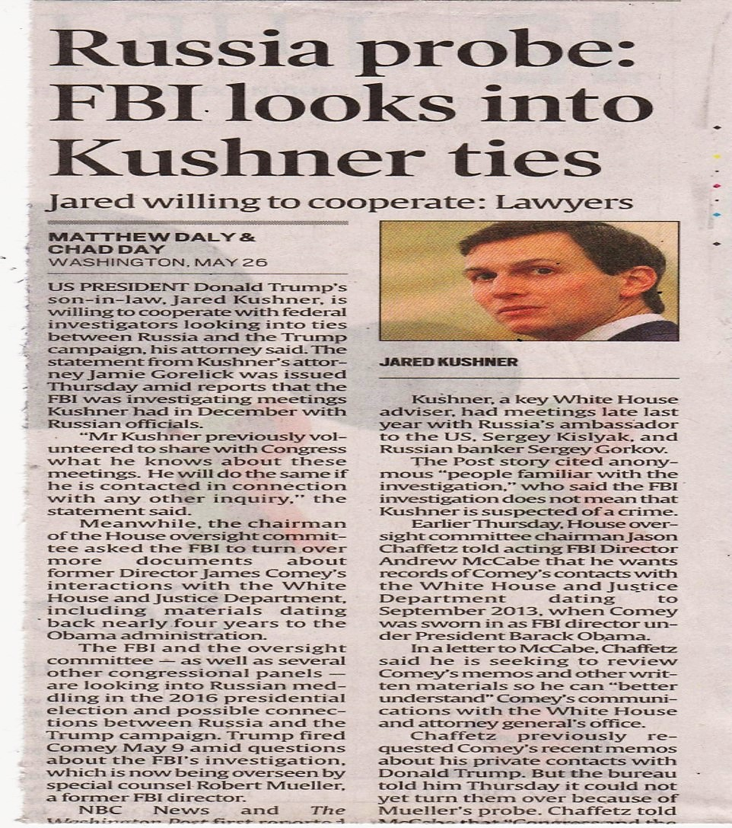

Slide 62
39 . ANSWER : A ( Eldest son )
Things / persons without blood relationship
OLD – OLDER -- OLDEST
OLD -- ELDER -- ELDEST
Persons with blood relationship

Slide 63
40 . ANSWER : A ( remove into )
ENTER : TO MOVE INTO A PLACE ( physically )
ENTER INTO : TO INVOLVE ( argument / conversation / agreement / deed / contract etc )

Slide 64
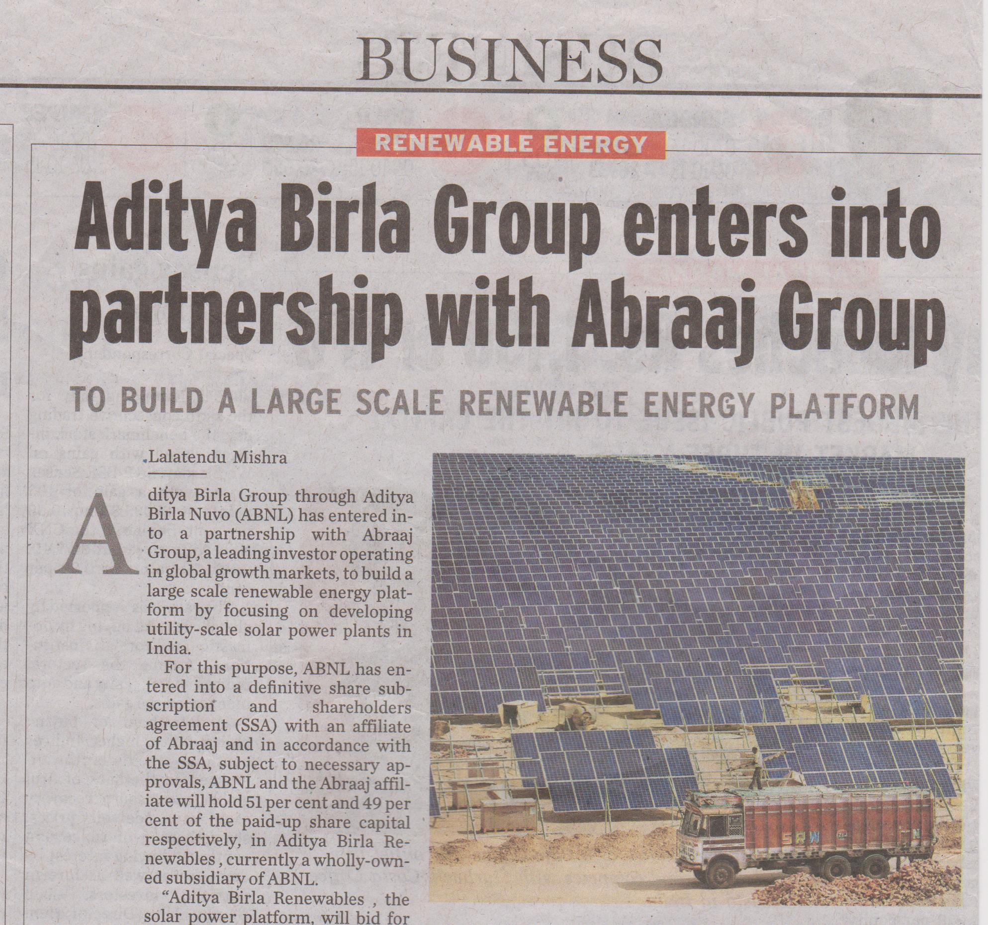

Slide 65
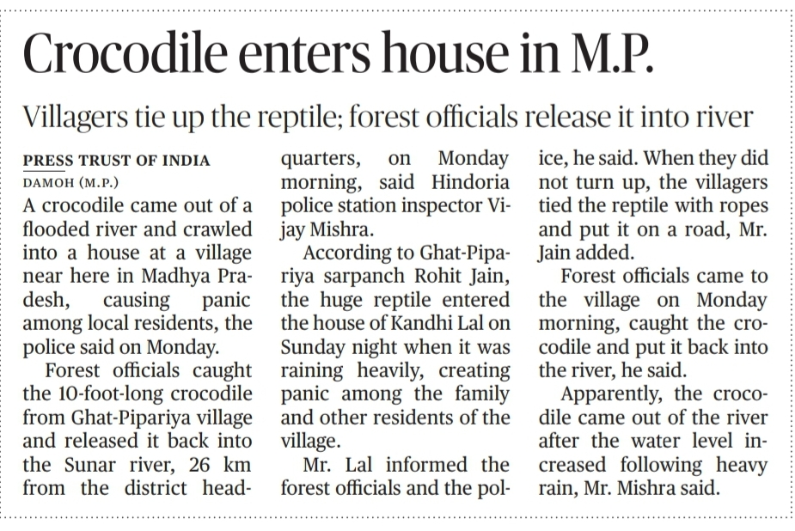

Slide 66
PRACTICE EXERCISE 2

Slide 67
1. ANSWER : B ( you are responsible )
In sentences having either - or , neither- nor, not only – but also the verb must agree with the subject that is after or / nor / but also
has
Either you or he have to finish this work .

Slide 68
2 . ANSWER : B ( I shall have finished )
We need future perfect tense to refer to an action that is before another action in future .
3 . ANSWER : B ( is returning )
The word that is given before with is the subject . If it is singular , we use singular verb , if it is plural , we use plural verb .

Slide 69
When we have a connective like
With, Together with, Along with, As well as,
In addition to, Besides,
But , Rather than,
accompanied by, apart from, aided by, including
The verb must agree with the subject before the connective.

Slide 70
4 . ANSWER : C ( remove about )
Discuss and describe do not take prepositions .
5 . ANSWER : C ( any in place of either )
Either and neither are used for 2 persons / things .
Any and none are used for 3 or more than 3 persons . Things .

Slide 71
6 . ANSWER : A ( they have been living )
Since they were married indicates time is given importance , so we need to use present perfect continuous tense .
7 . ANSWER : B ( how old you were )
We use verb before subject in direct question .
Ex : what is your name ?
We use verb after subject in indirect question .
Ex :
May I know what your name is ?

Slide 72
8 . ANSWE R : A ( has turned up )
None takes a singular a singular verb .
9 . ANSWER : C ( she was weeping )
“ WHEN “ is used as connective not as an interrogative word .
10 . ANSWER : B ( either sufficient or enough )
We can not use two words which give the same meaning .

Slide 73
11 . ANSWER : C ( himself / herself in place of oneself )
Oneself is correct if the subject is ONE but the subject here is EACH … so we need to use himself or herself .
12 . ANSWER : A ( if the police had worked )
Type 3 conditional

Slide 74
TYPE 3
If + sub + had + V3 + Object →
sub + would / should / could / might + have + V3 + Object
If I had taken coaching , I would have got good marks.
PAST 0%

Slide 75
13 . ANSWER : A ( I saw him )
A past action with time should be expressed in simple past tense not present perfect tense .
14 . ANSWER : A ( charged with murder )
Accuse takes of but charge takes with .

Slide 76
15 . ANSWER : D ( no error )
16 . ANSWER : A ( use either suppose or if )
We cannot use two words that have the same meaning together .
17 . ANSWER : C ( protecting it )
For a singular noun called NATION , we need a singular pronoun IT

Slide 77
18 . ANSWER : B ( what he is doing )

Slide 78
18 . ANSWER : B ( what he is doing )
‘ What ‘ is used as a connective here . not as an interrogative word .
What is he doing ? ( question )
I do not know what he is doing . ( statement )

Slide 79
19 . ANSWER : C ( remove THE before bed )
No article is used before the places
like School, College, Hospital, prison , Church , masjid , Temple , bed etc .
When they are used for primary
purpose.

Slide 80
20 . ANSWER : C ( called into question )
Call into question : to suspect / doubt

Slide 81
VOCABULARY

Slide 82
SYNONYMS
PRACTICE EXERCISE 1
1 . ANSWER : B
Judicious = wise , thoughtful , clever .
2 . ANSWER : C
Transpired = happened
3 . ANSWER : B
Obstinate = stubborn , inflexible , unyielding ( opposite of yielding )
4 ANSWER : B
Sundry = various , diverse , varied

Slide 83
5 . ANSWER : A
Menial = unskilled , lowly .low-grade .
6 . ANSWER : D
IMPETUS = momentum ( something that makes a process happen / happen quickly. )
7 . ANSWER : C
Emulate : to imitate , follow , copy .

Slide 84
8 . ANSWER : A
Sedentary : sitting , seated , deskbound .
9 . ANSWER : B
Callous : insensitive , heartless , brutal ,
10 . ANSWER : A
Annoyance , irritation , vexation .

Slide 85
PRACTICE EXERCISE - 2
1 . ANSWER : A
Clamour – shout , yell , scream .
2 . ANSWER : A
Intriguing – interesting , engaging , tempting .
3 . ANSWER : B
Penchant – a strong liking for something , fondness , inclination .

Slide 86
4 . ANSWER : A
Lucrative – rewarding , profit making , money making
5 . ANSWER : D
Improvident - Spendthrift , lavish , uneconomical . ( opposite of provident )
6 . ANSWER : A
Ostrasize – exclude , separate .
7 . ANSWER : B
Pejorative – derogatory , insulting , disparaging .

Slide 87
8 . ANSWER : B
Garner – collect , gather , accumulate .
9 . ANSWER : A
Miffed - annoyed , displeased , offended .
PRACTICE EXERCISE - 3
1 . ANSWER : A
Bemoan – lament , express sorrow over something .
2 . ANSWER : B
Incumbent : current ,present , existing .

Slide 88
3 . ANSWER : C
Aggrieved – unhappy , angry , distressed .
4 . ANSWER : C
Plethora – abundance , surplus , excess .
5 . ANSWER : B
Allocation – allotment , grant .

Slide 89
ANTONYMS
1 . ANSWER : C CRAVEN means timid , cowardly , lacking courage …its opposite is BOLD .
2 . ANSWER : B
CARPING means criticising , fault finding , complaining ….its opposite is UNCRITICAL .
3 . ANSWER : SAGE means a philosopher , very wise ……its opposite FOOL .
4 . ANSWER : D AMELIORATION means improvement , betterment ….its opposite is AGGRAVATION means worsen , make worse .

Slide 90
5 . ANSWER : B ALACRITY means keen ness , readiness , sharpness …..its opposite is SLOWNESS .
6 . ANSWER : C ASSUAGE means make a unpleasant thing less intense , relieve , ease , soothe ….its opposite is WORSEN
7 . ANSWER : A BLAND means dull , tasteless . Boring…. its opposite is CAUSTIC meaning biting , sharp , bitter .

Slide 91
8 . ANSWER : D LATENT means inactive , unapparent , unseen , undeveloped …its opposite is OBVIOUS which means clear .
9 . ANSWER : B JADED means dull , tired … its opposite is STIMULATED …..meaning energising , refreshing .
10 . ANSWER : B LAMPOON means .. Publicly criticise , ridicule , mock , make fun of … its opposite is PRAISE .

Slide 92
PRACTICE EXERCISE 2
1 . ANSWER : A PAROCHIAL means NARROW MINDED , ILLIBERAL its opposite is BROADMINDED .
2 . ANSWER : B FICKLE means inconstant , changing frequently , inconstant … its opposite is CONSTANT .
3 . ANSWER : A DISGRUNTLED means dissatisfied , unhappy , discontented …its opposite is CONTENTED .
4 . ANSWER : C VIBRANT means full of energy , high spirited , energetic … its opposite is PALE meaning DULL .

Slide 93
5 . ANSWER : FORBIDDING means UNFRIENDLY , UNWELCOME , HARSH … its opposite is INVITING
6 . ANSWER : C REPRIMAND means scold , censure , criticise … its opposite is PRAISE .
7 . ANSWER : D LUSH means abundant , luxurious , thick its opposite is SPARSE meaning THIN , SCATTERED ,LIMITED .

Slide 94
8 . ANSWER : A TENTATIVE means not certain , unconfirmed , indefinite …. Its opposite is DEFINITE .
9 . ANSWER : A MARVELLOUS means amazing , extraordinary , awesome …. Its opposite is AWFUL
10 . ANSWER : B PASSIONATE means excited , zealous , intense …..its opposite is APATHETIC meaning indifferent , unconcerned , uninterested .

Slide 95
PRACTICE EXERCISE - 3
1 . ANSWER : A DIFFIDENCE means lack of confidence , timidity , self doubt . …. Its opposite is BOLDNESS .
2 . ANSWER : C SUPERFICIAL means surface , not deep , slight …..its opposite is THOROUGH meaning in-depth , detailed , exhaustive .
3 . ANSWER : A RECKLESS means thoughtless , rash , careless ……its opposite is CAREFUL .
4 . ANSWER : C SCORN means derision , mockery , contempt ….its opposite is ADMIRATION .

Slide 96
5 . ANSWER : A GRANDIOSE means grand , impressive , superb …..its opposite is SIMPLE .
6 . ANSWER : A TRIVIAL means negligible unimportant , of little value its opposite is SERIOUS .
7 . ANSWER : B LURID means over bright , glaring …..its opposite is MILD .

Slide 97
8 . ANSWER : A LOQUACIOUS means talkative , garrulous …..its opposite is RESERVED .
9 . ANSWER : A UNSRUPULOUS means unethical , unprincipled ,immoral ……its opposite is CONSCIENTIOUS meaning dedicated , careful , moral .
10 . ANSWER : B CONFISCATE means take away , seize ….its opposite is RELEASE .

Slide 98
ANALOGY
1 . ANSWER : C a gullible person can be duped ( cheated ) easily because he readily believes others …… as the malleable person or thing can be moulded .
2 . ANSWER : D Eulogy means praise antonym of blame …..benediction is blessing opposite of curse
3 . ANSWER : B rout and defeat are synonyms ….same as ovation and applause .
4 . ANSWER : A skinflint and stingy are synonyms as diehard and stubborn .

Slide 99
5 . ANSWER : C Indolent means lazy …. A lazy person avoids work and a taciturn avoids to speak .
TACITURN : A PERSON WHO IS HABIYUALLY SILENT .
6 . ANSWER : B fire leaves ashes as event leaves memories
7 . ANSWER : A fox is cunning and beaver is hard working by nature .
8 . ANSWER : C mitigate and sentence are very similar in meaning …… to reduce , lessen , make something less severe , punishment can be mitigated as sentence can be commuted ,
Other meaning of commute is…. To travel

Slide 100
9 . ANSWER : A skulduggery and chicanery are same in meaning ( dishonesty , cheating ) swindler and trickster are same in meaning . ( cheat , fraudster )
10 . ANSWER : D minatory and threaten are synonyms same as laudatory and praise are same in meaning .
11 . ANSWER : B Ramshackle and soundness are antonyms same as garbled and clarity .
RAMSHACKLE : broken down , in bad shape , ruined .
GARBLED : unclear , confusing .
12 . ANSWER : D dispassionate and partisanship are antonyms same as intemperate and moderate .
Dispassionate : Rational and impartial ……partisanship : biased , partial .
Intemperate : excessive , immoderate

Slide 101
13 . ANSWER : B laugh and guffaw are synonyms same as quarrel and squabble .
14 . ANSWER : B callow and maturity are opposite words same as incipient and fruition .
INCIPIENT : initial , starting , nascent
FRUITION : maturity , fulfilment . Completion .
15 . ANSWER : D .… opposite relationship .
16 . ANSWER : C …. Opposite relationship .
17 . ANSWER : A …. Opposites .
18 . ANSWER : B snail lacks celerity as peacock lacks humility
CELERITY : SPEED , VELOCITY , SWIFTNESS .
HUMILITY : MODESTY , HUMBLENESS , NOT PROUD .

Slide 102
SENTENCE COMPLETION
1 . ANSWER : B ( incriminating evidence : something that shows that someone is guilty )
2 . ANSWER : D fearlessly skied down …is the key to the answer .
3 . ANSWER : C clog means block …congestion is the key word .
4 . ANSWER : A justified means …..Uphold , approve , support .
5 . ANSWER : D list of high art , folk , rock , theology and economics ….is the key word so versatile is the suitable word which means allround , multifaceted , - .

Slide 103
6 . ANSWER : D …rather than unyielding attitude ..is the key to decide that answer is compromise .
7 . ANSWER : C TRIUMPH means to get a victory .
8 ANSWER : A soporific means causing sleep …. Drowsy means sleepy …perfect combination .
9 . ANSWER : D …gave up is the key word to decide that answer is FUTILE which means useless .
10 . ANSWER : A ENDEMIC means a problem or a disease regularly found and very common in a particular area .

Slide 104
Dear students , pls feel free to ask me doubts through whatsapp .
9 9 8 5 1 4 3 8 1 7

